Slide 1
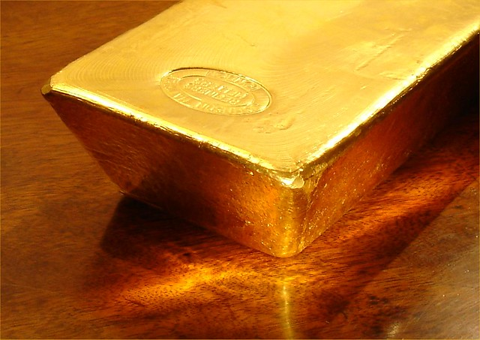

PREDICTION OF GOLD PRICE BY MULTIPLE REGRESSION

Slide 2

Department Of Statistics F.YM.Sc Regression /Multivariate Project : Project Guide- Dr. Hemant Kulkarni Group Members:- Vedangee Patkar- 11322320063 Aftab Tamboli- 11322320136 Shambhavi Pandey-1132232070

Slide 3
Introduction
In the ever-evolving landscape of financial markets, gold remains a timeless and sought-after asset. Its allure lies not only in its intrinsic value but also in its ability to act as a hedge against economic uncertainties. Investors, policymakers, and financial analysts closely monitor gold prices, seeking insights into global economic trends and geopolitical events.
In this project, we embark on a journey to unravel the intricate relationship between gold prices and various economic factors. By employing multiple linear regression, we aim to construct a robust predictive model that estimates gold prices based on relevant predictors. Whether you’re a seasoned investor or a curious data enthusiast, this project promises to demystify the dynamics behind this precious metal.

Slide 4
Objective
To know what are the factors at which the gold price will depend upon.
To check whether there is any other factor ,beside time variation on which the prediction of gold price depends .
To check which model is better to predict the Gold price .
To know that if there is any limitation in our data or there is some factor lacking ,as by removing such factor our study of dataset can be much better .

Slide 5
Preview of Dataset
Our dataset comprises a comprehensive collection of economic indicators and gold price records. Here is a snapshot of the dataset’s structure:
Gold_Price: The price of gold per ounce, serving as the dependent variable.
Crude_Oil: Prices of crude oil, which may influence gold prices as both are considered commodities.
Interest_Rate: The prevailing interest rates, as they can affect investment decisions in gold.
USD_INR: The exchange rate between the US Dollar and Indian Rupee, reflecting global economic strength.
Sensex: The stock market index representing 30 well-established and financially sound companies listed on the Bombay Stock Exchange.
CPI: Consumer Price Index, indicating inflation levels which can impact gold prices.
USD_Index: An index measuring the value of the US Dollar against a basket of foreign currencies.
Each record in the dataset corresponds to a daily observation of these variables over several years, providing a rich temporal dimension for our analysis

Slide 6
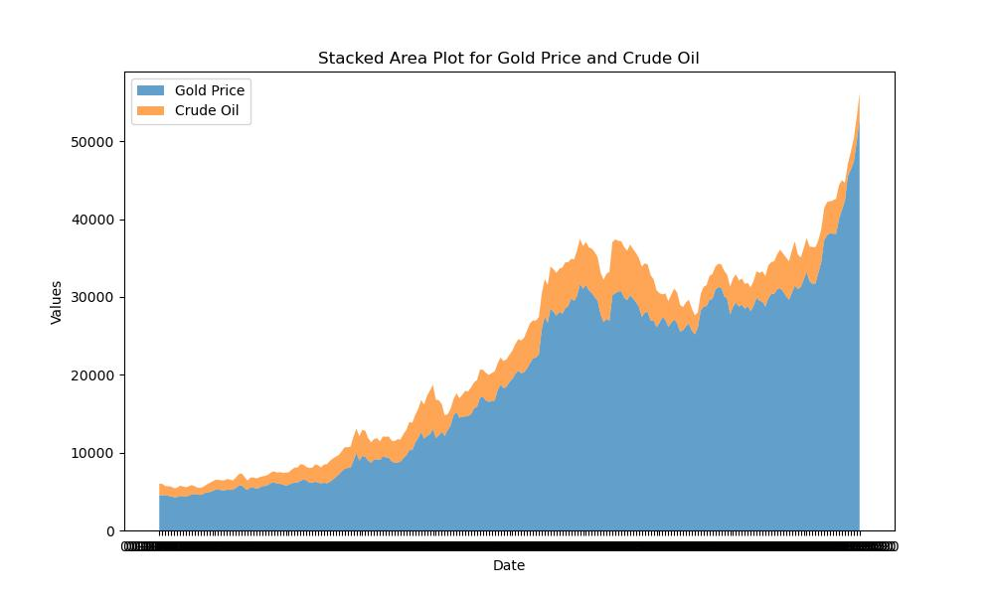
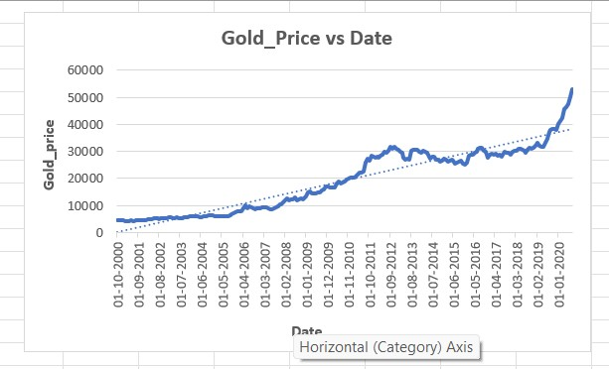
EDA
1.This chart shows that as time progresses ,the gold price fluctuates but generally shows the upward trend, but crude oil shows somewhat same fluctuations as of gold price.
2. The graph suggests that both commodities are valuable and sensitive to global events.
3. Investors and analysts track both gold and crude oil prices to understand economic trends and make informed decisions .
1. The line chart indicates an overall upward trend in gold prices over the 20-year period .
2. There is a significant rise in gold prices toward the end of the timeline ,around 2020 .
3. The dotted line suggests the long term average growth rate of the gold prices ,while the solid blue line represents the actual data ,which includes fluctuation but generally follows upward trajectory.

Slide 7
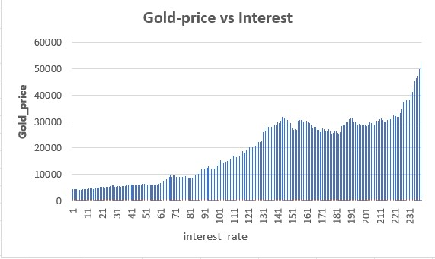
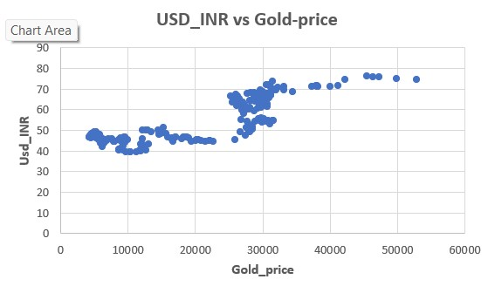
1.Each bar represents a data point correlating a specific interest rate to a gold price.
2. The bars indicate an upward trend ,suggesting that as interest rate increases ,gold prices also tend to rise .
1.The data points are scattered across the chart ,mostly concentrated in a horizontal band-like formation .This suggests that there is no clear trend or strong correlation between the two variables.
2.The lack of a distinct pattern indicates that the gold price does not have a consistent impact on the USD to INR exchange rate within the observed range .

Slide 8
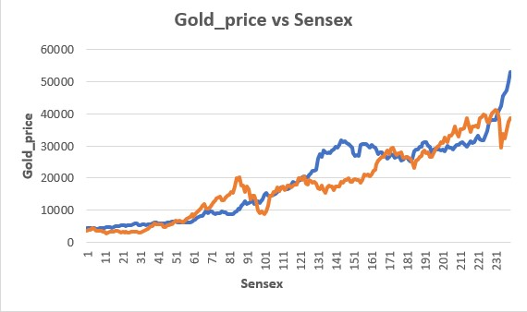
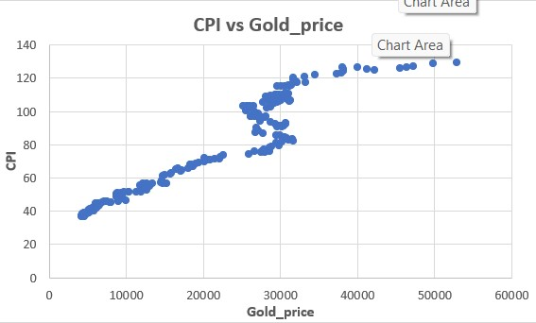
1.The graph is used to analyze the relationship between the gold price and stock market performance ,which may be inversely related during certain periods as investors often turn to gold as a safe haven when the stock market is volatile .
2. Both lines show an upward trend ,indicating an increase in values over the time ,but with different patterns of rises and falls .
1.The data points form an upward trend ,indicating a positive relationship between the gold price and CPI.
2.As the CPI increases ,the gold price also tends to increase, suggesting that higher gold prices may be associated with higher consumer prices.

Slide 9
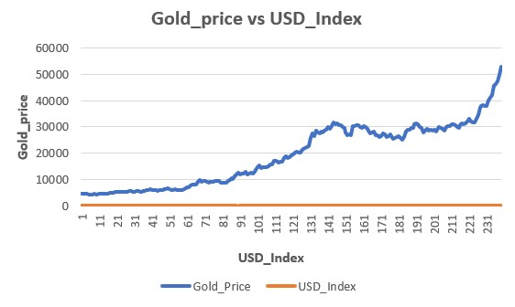
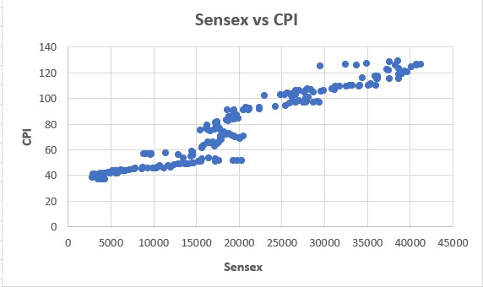
1.The data points indicates the positive correlation as the the Sensex increases ,the CPI also increases
2. This relationship may suggest that the stock price increases ,the inflation i.e. the CPI also increases
1.The graph suggest that as the gold price has experienced the overall increase but , the USD index does not show any significant change during the same period .
2. The stable USD index alongside the rising gold price indicates the the investor preference for the gold as a safe-haven asset for the the period of uncertainty and stable currency

Slide 10
Multiple Linear Regression
Multiple Linear Regression is a statistical technique used to predict the value of a dependent variable based on the values of two or more independent variables . The goal is to model the linear relationship between the dependent variable and independent variable .
Key Assumptions:-
1.Linear Relationship: There should be a linear relationship between the dependent variable and each of the independent variable .
2.No Multi Collinearity: The independent variable should not be highly correlated as this can affect the reliability of coefficient estimates.
3.Homoscedasticity: The residuals should have constant variance across all levels of the independent variables.
4.Normality of Errors : This assumption states that the probability distribution of the errors should be normal distributed centred around the zero.

Slide 11
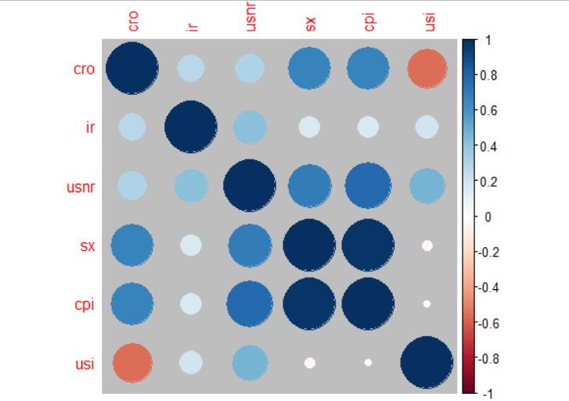
Checking if regressors are uncorrelated.
Most of the VIF values are too large suggesting collinearity among regressors
1. The correlation plot is suggesting that the regressors sx(Sensex) and cpi(CPI) exhibit a strong positive correlation.
2. This is violating our assumption so we need to carryout transformation of regressors if possible
Notes:
Here, we see that the VIF values for most of the regressor are very high, this is suggesting that there might be correlation among regressors, lets verify.

Slide 12
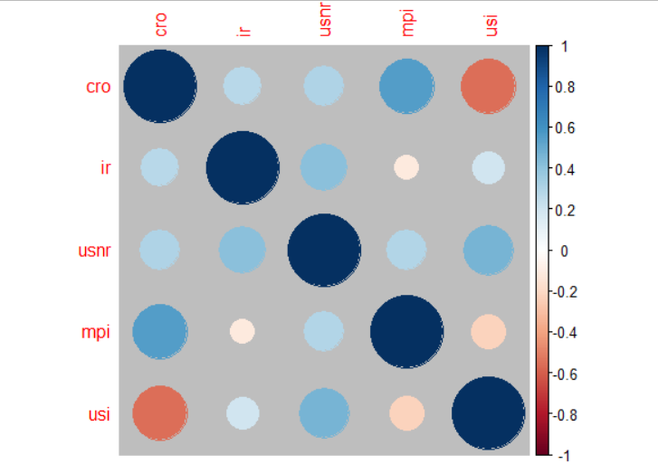

Transformation of Regressor
After some research we found that we can use,
Market Price Index(MPI) = $\frac{Sensex}{CPI}$
1.After this transformation, our VIF values are lying in the range 0-5 and also the correlation among regressors is negligible.
So, the first assumption of multiple regression model is satisfied.

Slide 13
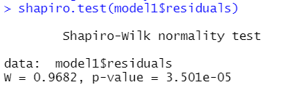
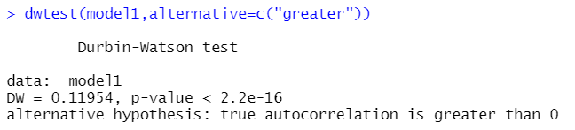
Checking if errors are distributed normally
As p value is close to zero we reject null hypothesis. This implies that the errors are not distributed normally
Also, since we have time series data there might be autocorrelation between the errors.
As p value is close to zero we reject the null hypothesis. This implies that there is positive autocorrelation among the errors.
So, if we wish to fit multiple linear regression model, first we need to handle the effect due to time on the gold price value.

Slide 14
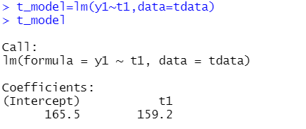
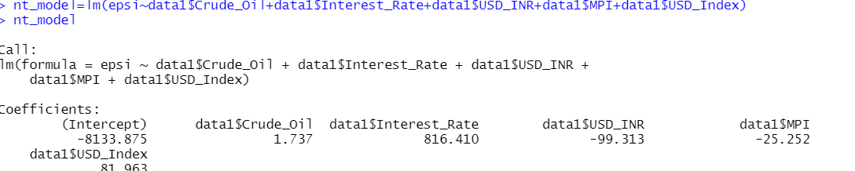
Removing Time effect and fitting the model
First we fit a simple linear regression model using time as regressor.
Then, we extract the residuals of this model which consists of effect of regressors and uncontrolled variance.
This residuals act as response variable for multiple linear regression model where time effect is subtracted.
After fitting the model we are left with the error which is due to unknown factors.

Slide 15
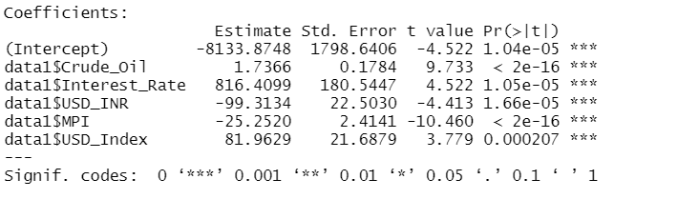
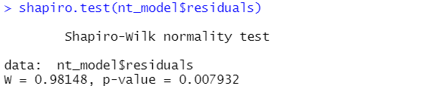
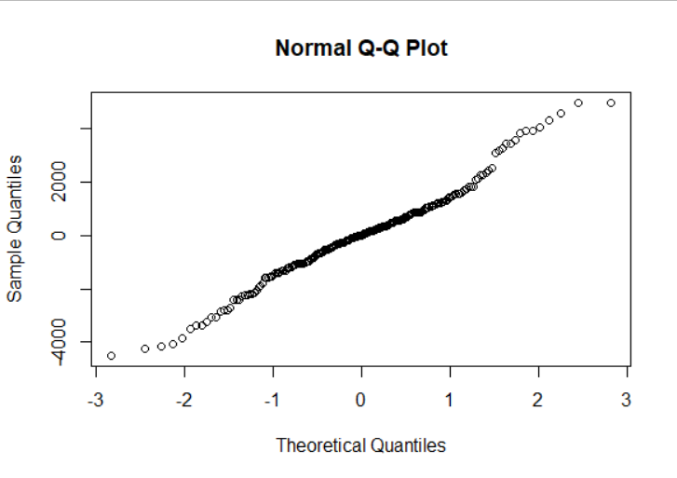
This shows that all our regressors are significant
1. For this regression model we found that errors are normally distributed so our issue is resolved.
2. This is one of the way we can fit model to predict the gold price.

Slide 16
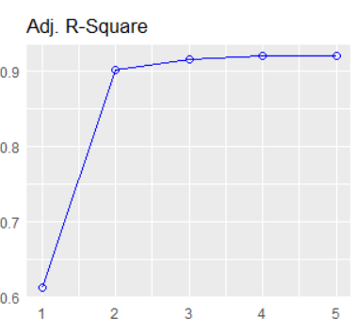
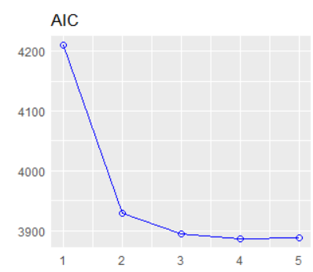
Subset Selection Approach
Many a times we come across regression models where there are huge number of regressors
So to reduce the load of collecting all data in future we try taking subsets of regressors which give us better or at least similar prediction
Here 5=(cro, ir, usnr, mpi, usi)
4=(cro, ir, usnr, usi)
The graph shows that adjusted r square value is maximum and AIC is minimum for 5th subset. This implies all the 5 regressors are necessary
But if we keenly observe, we see that even the 4th subset gives almost same results
So we can try fitting model with only 4 regressors(excluding MPI) and see if it gives almost same output.

Slide 17
Other Models
Model2 : Fitting mlr without removing time effect
Model3 : Fitting mlr excluding Market Price Index and without removing time effect
Model4 : Fitting mlr excluding Market Price Index and by removing time effect

Slide 18
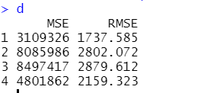
Comparison and Conclusion
As the MSE and RMSE of model 1 is least, its better than any other model
This has led us to the following conclusion
Gold Price can be predicted when we have information about all regressors
Time factor also plays a significant role in estimating the gold price
Developing the relation between Sensex and CPI has led us to a more better conclusion
Note:
Even after removing the time factor errors are auto correlated to some extent.
So in future we would try to use models like arima which might give us more refined results.

Slide 19
Thank You

